Slide 1
Obesity Rate in the U.S.
Team:
Olivia Liang, Patrick Seng, Pavan Vinnakota, William Wu

Slide 2


Slide 3
Target Question
Key Question:
What factors influence the obesity rate in the United States?
Why this important:
General understanding
Policy change

Slide 4
Data Preparation
Collecting Process:
U.S. Census Data
Food Environment Atlas - U.S. Dept. of Agriculture
CDC. Gov
Cleaning Process:
Mapping county level data
Removed certain records
Notes:
Which variables came from where?
Mention county level data
Talk through how we collected and combined our data sets
Removed Puerto Rico
not all data sets had data
Removed counties for which they a Obesity Rate

Slide 5

Closer Look the Data - Predictor Variables
Fast Food Restaurants *
Full Service Restaurants *
Grocery Stores *
Fitness Centers *
Percent Unemployed
Poverty Rate
Median Income
* Per 1000 Residents
Notes:
We made the bold variables per thousand people to reduce bias by population sizes of counties

Slide 6
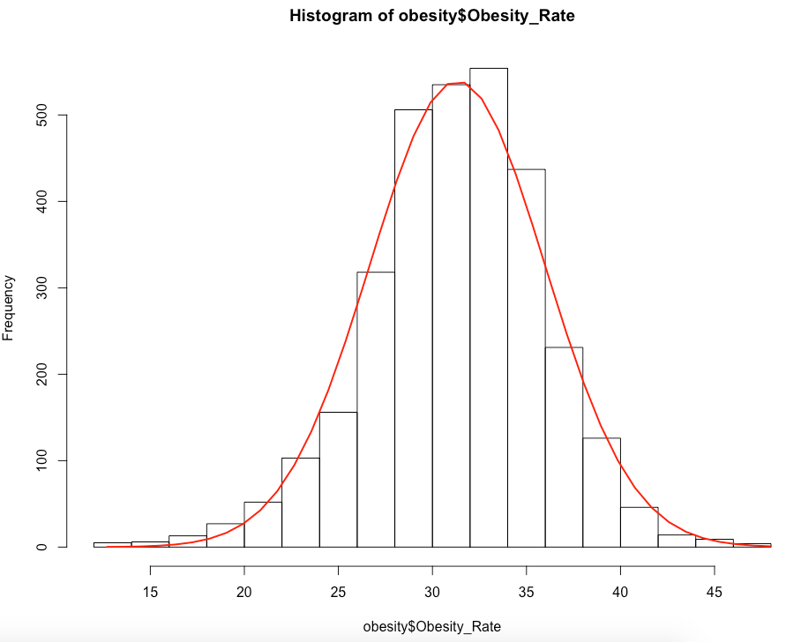
Closer Look the Data - Response Variable
Nationwide:
Mean Obesity Rate : 31.33%
Median : 31.55%
Range: 12.7% - 48.0%
Q1: 28.50% Q3: 34.40%

Slide 7
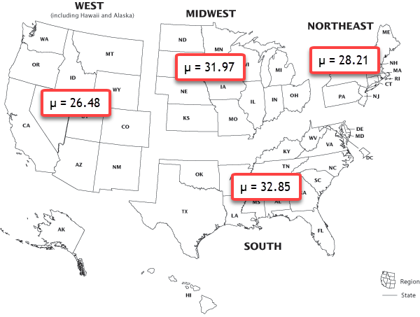
Regional Analysis
Mean Obesity Rates in across the United States
Are regions different?
Notes:
Explain how we divided the regions - (the official census map has regions and sub regions)
Explain the ANOVA that we ran and its findings - (significant difference in regions)
Explain the Tukey Test and its findings - (significant difference between all regions)

Slide 8
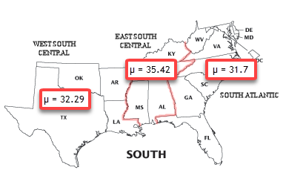
Regional Analysis
Within regions
Within sub-regions
Notes:
Explain that we wanted to look further into the worst region - South
Explain ANOVA results - (difference in means)
Explain Tukey results - (difference between both regions and East South Central, no difference between West South Central and South Atlantic)

Slide 9
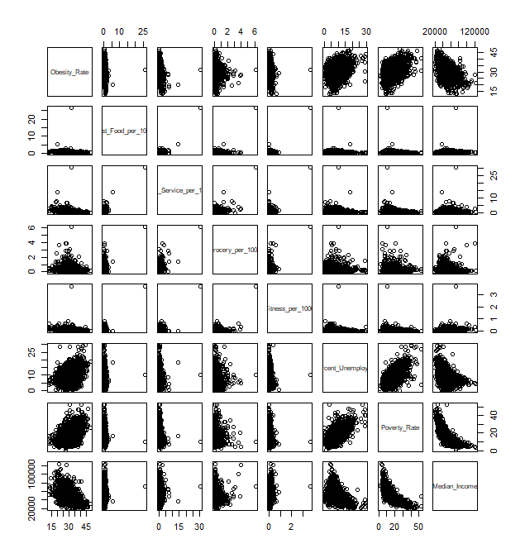
Check Collinearity
Drop One:
Medium Income & Poverty Rate highly correlated (-.74)
Still collinearity present but we will proceed with caution
Notes:
Talk about this large cor coefficient (.74)

Slide 10
Building a Model
After removing insignificant and collinear predictor variables
Our Final Model:
Obesity Rate = 𝛃₀ + 𝛃₁(Fast Food Restaurants) +
𝛃₂(Full Service Restaurants) + 𝛃₃(Fitness Centers) +
𝛃₄(Percent Unemployed) + 𝛃₅(Median Income) + 𝛃₆(State*) + 𝝴
* State Represented as Factor
Notes:
After

Slide 11
Model Interpretation
H₀: There is no relationship between our predictor variables and the Obesity Rate in the United States
There is evidence to reject our null hypotheses
.00000000000000022% chance of seeing these results if there is no relationship
Sizeable Predictor Variable Coefficients:
Fast Food per 1000 +1.2
Full Service per 1000 -1.11
Fitness per 1000 -2.73
Notes:
Interpret the coefficients

Slide 12
Adding States to Model
What do our State Coefficients tell us?
Base Case:
West Virginia: 36.54% Obesity Rate
Notable coefficients:
California: -11.42
Alabama: - 0.39
Minnesota: - 4.50

Slide 13
Our Model Isn’t Perfect
Multiple R² Value
Our model captures 63.22% of the variation in Obesity Rate in counties across the United States
Future Considerations
Overall Activity Level
Metabolism Rates
Genetics
Medical Conditions
Notes:
Is this good?
We don’t know, we think based on the data we had, we’ve selected the best model keeping in mind collinearity issues, significant variables etc.
we can think of some things that might help the model

Slide 14

Key Takeaways
Possible Legislation
Quotas on Fast Food Restaurants in a Region
Provide Incentives to Full Service Restaurants
Implement Exercise Programs in Critical States

Slide 15

THANK YOU!!

